Slide 1
2
0
0907
1
X
BLEND
Beautiful of Design

Slide 2
目 录
CONTENT
01
02
03
04
项目背景
解决方案
预期目标
实施计划

Slide 3
项目背景
Part
01
外国环境分析
竞争对手解谜
目前市场现状

Slide 4

关于我们
ABOUTUS
Just for today I will exercise my soul in three ways. I will do somebody a good turn and not get found out: If anybody knows of it, it will not count. I will do at least two things I don‘t want to do—just for exercise. I will not show anyone that my feelings are hurt: they may be hurt, but today I will not show it.

Slide 5
01
在此添加标题
Just for today I will exercise my soul in three ways. I will do somebody a good turn and not get found out: If anybody knows of it, it will not count. I will do at least two things I don‘t want to do—just for exercise. I will not show anyone that my feelings are hurt: they may be hurt, but today I will not show it.
65%
51%
ADD TITLE
IF YOU LIKE THIS POWERPOINT TEMPLATE,PLEASE FOCUS ON ME,YOU WILL GET BETTER.
ADD TITLE
IF YOU LIKE THIS POWERPOINT TEMPLATE,PLEASE FOCUS ON ME,YOU WILL GET BETTER.
25%
-5%
-10%
-17%
-13%

Slide 6
01
在此添加标题
Just for today I will exercise my soul in three ways. I will do somebody a good turn and not get found out: If anybody knows of it, it will not count. I will do at least two things I don‘t want to do—just for exercise. I will not show anyone that my feelings are hurt: they may be hurt, but today I will not show it.
ADD TITLE
IF YOU LIKE THIS POWERPOINT TEMPLATE,PLEASE FOCUS ON ME,YOU WILL GET BETTER.
ADD TITLE
IF YOU LIKE THIS POWERPOINT TEMPLATE,PLEASE FOCUS ON ME,YOU WILL GET BETTER.
ADD TITLE
IF YOU LIKE THIS POWERPOINT TEMPLATE,PLEASE FOCUS ON ME,YOU WILL GET BETTER.
60%
30%
80%

Slide 7
01
在此添加标题
Just for today I will exercise my soul in three ways. I will do somebody a good turn and not get found out: If anybody knows of it, it will not count.
60%
CONTRAST
92%
ADD YOUR TITLE
ADD YOUR TITLE
IF YOU LIKE THIS POWERPOINT TEMPLATE,PLEASE FOCUS ON ME,YOU WILL GET BETTER.
IF YOU LIKE THIS POWERPOINT TEMPLATE,PLEASE FOCUS ON ME,YOU WILL GET BETTER.

Slide 8
01
在此添加标题
Just for today I will exercise my soul in three ways. I will do somebody a good turn and not get found out: If anybody knows of it, it will not count. I will do at least two things I don‘t want to do—just for exercise. I will not show anyone that my feelings are hurt: they may be hurt, but today I will not show it.
ADD YOUR TITLE
ADD YOUR TITLE
ADD YOUR TITLE
IF YOU LIKE THIS POWERPOINT TEMPLATE,PLEASE FOCUS ON ME,YOU WILL GET BETTER.
IF YOU LIKE THIS POWERPOINT TEMPLATE,PLEASE FOCUS ON ME,YOU WILL GET BETTER.
IF YOU LIKE THIS POWERPOINT TEMPLATE,PLEASE FOCUS ON ME,YOU WILL GET BETTER.

Slide 9
解决方案
Part
02
项目的理解
我们的解决方案
我的优势
PPT模板下载：www.1ppt.com/moban/ 行业PPT模板：www.1ppt.com/hangye/
节日PPT模板：www.1ppt.com/jieri/ PPT素材下载：www.1ppt.com/sucai/
PPT背景图片：www.1ppt.com/beijing/ PPT图表下载：www.1ppt.com/tubiao/
优秀PPT下载：www.1ppt.com/xiazai/ PPT教程： www.1ppt.com/powerpoint/
Word教程： www.1ppt.com/word/ Excel教程：www.1ppt.com/excel/
资料下载：www.1ppt.com/ziliao/ PPT课件下载：www.1ppt.com/kejian/
范文下载：www.1ppt.com/fanwen/ 试卷下载：www.1ppt.com/shiti/
教案下载：www.1ppt.com/jiaoan/
字体下载：www.1ppt.com/ziti/

Slide 10
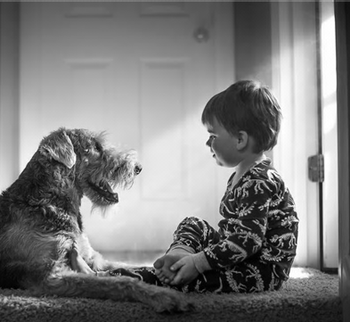
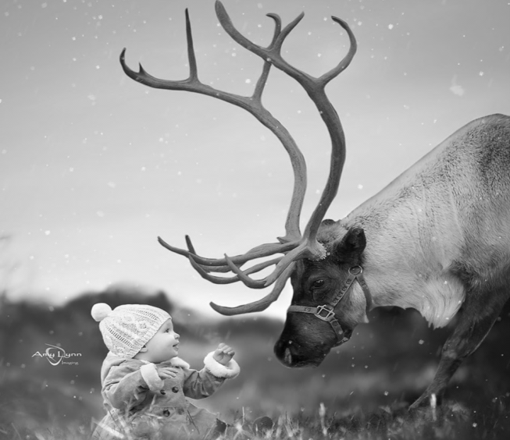
ADD YOUR PROJECT TITLE
Just for today I will exercise my soul in three ways. I will do somebody a good turn and not get found out: If anybody knows of it, it will not count. I will do at least two things I don‘t want to do—just for exercise. I will not show anyone that my feelings are hurt: they may be hurt, but today I will not show it.
ADD YOUR PROJECT TITLE
Just for today I will exercise my soul in three ways. I will do somebody a good turn and not get found out: If anybody knows of it, it will not count. I will do at least two things I don‘t want to do—just for exercise. I will not show anyone that my feelings are hurt: they may be hurt, but today I will not show it.

Slide 11

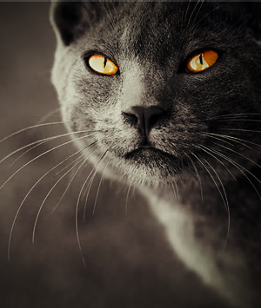
时
尚
ADD YOUR PROJECT TITLE
BLACK
&
AWHITE

Slide 12
ADD TITLE
ADD TITLE
IF YOU LIKE THIS POWERPOINT TEMPLATE,PLEASE FOCUS ON ME,YOU WILL GET BETTER.
IF YOU LIKE THIS POWERPOINT TEMPLATE,PLEASE FOCUS ON ME,YOU WILL GET BETTER.
SWOT
ANAIYSIS
ADD TITLE
ADD TITLE
IF YOU LIKE THIS POWERPOINT TEMPLATE,PLEASE FOCUS ON ME,YOU WILL GET BETTER.
IF YOU LIKE THIS POWERPOINT TEMPLATE,PLEASE FOCUS ON ME,YOU WILL GET BETTER.

Slide 13

BLACK
&
AWHITE
92
53
25
17
ADD TITLE
ADD TITLE
ADD TITLE
January
February
march
April
IF YOU LIKE THIS POWERPOINT TEMPLATE.
IF YOU LIKE THIS POWERPOINT TEMPLATE.
IF YOU LIKE THIS POWERPOINT TEMPLATE.

Slide 14
02
在此添加标题
ADD TITLE
ADD TITLE
ADD TITLE
IF YOU LIKE THIS POWERPOINT TEMPLATE.
IF YOU LIKE THIS POWERPOINT TEMPLATE.
IF YOU LIKE THIS POWERPOINT TEMPLATE.

Slide 15
预期目标
Part
03
预期实现订单额
新开发客户数
市场份额获得突破

Slide 16
2
ADD TITLE
ADD TITLE
1
IF YOU LIKE THIS POWERPOINT TEMPLATE.
IF YOU LIKE THIS POWERPOINT TEMPLATE.
目
标
3
ADD TITLE
ADD TITLE
4
IF YOU LIKE THIS POWERPOINT TEMPLATE.
IF YOU LIKE THIS POWERPOINT TEMPLATE.

Slide 17
ADD YOUR TITLE
45%
IF YOU LIKE THIS POWERPOINT TEMPLATE.
ADD YOUR TITLE
35%
IF YOU LIKE THIS POWERPOINT TEMPLATE.
ADD YOUR TITLE
BLACK
&
AWHITE
IF YOU LIKE THIS POWERPOINT TEMPLATE.
44%
ADD YOUR TITLE
25%
IF YOU LIKE THIS POWERPOINT TEMPLATE.
ADD YOUR TITLE
15%
IF YOU LIKE THIS POWERPOINT TEMPLATE.

Slide 18
03
在此添加标题
Just for today I will exercise my soul in three ways. I will do somebody a good turn and not get found out: If anybody knows of it, it will not count. I will do at least two things I don‘t want to do—just for exercise. I will not show anyone that my feelings are hurt: they may be hurt, but today I will not show it.
ADD TITLE
ADD TITLE
IF YOU LIKE THIS POWERPOINT TEMPLATE.
IF YOU LIKE THIS POWERPOINT TEMPLATE.
ADD TITLE
ADD TITLE
IF YOU LIKE THIS POWERPOINT TEMPLATE.
SUBTITLE
TTTLE HERE
IF YOU LIKE THIS POWERPOINT TEMPLATE.

Slide 19
03
在此添加标题
Just for today I will exercise my soul in three ways. I will do somebody a good turn and not get found out: If anybody knows of it, it will not count. I will do at least two things I don‘t want to do—just for exercise. I will not show anyone that my feelings are hurt: they may be hurt, but today I will not show it.
48%
94%
88%
TITLE HERE
46%
TITLE HERE
39%
TITLE HERE
TITLE HERE
TITLE HERE

Slide 20
03
在此添加标题
Just for today I will exercise my soul in three ways. I will do somebody a good turn and not get found out: If anybody knows of it, it will not count. I will do at least two things I don‘t want to do—just for exercise. I will not show anyone that my feelings are hurt: they may be hurt, but today I will not show it.
94%
63%
42%
TITLE HERE
23%
TITLE HERE
TITLE HERE
TITLE HERE

Slide 21
实施计划
Part
04
项目团队人员结构
项目实施计划
项目风险控制

Slide 22
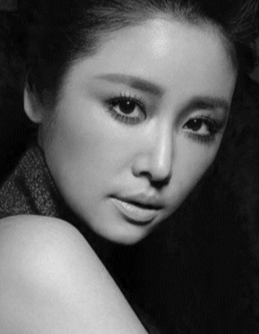
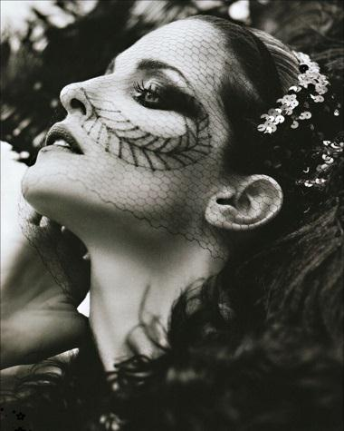

Just for today I will exercise my soul in three ways. I will do somebody a good turn and not get found out: If anybody knows of it, it will not count.
PHOTO’S
3D SHOW
ADD YOUR TITLE
ADD YOUR TITLE
ADD YOUR TITLE

Slide 23
04
在此添加标题
STEP 03
ADD TITLE
Just for today I will exercise my soul in three ways. I will do somebody a good turn and not get found out.
STEP 02
ADD TITLE
Just for today I will exercise my soul in three ways. I will do somebody a good turn and not get found out.
STEP 01
ADD TITLE
Just for today I will exercise my soul in three ways. I will do somebody a good turn and not get found out.

Slide 24
04
在此添加标题
Just for today I will exercise my soul in three ways. I will do somebody a good turn and not get found out: If anybody knows of it, it will not count.
ADD TITLE
IF YOU LIKE THIS POWERPOINT TEMPLATE.
1
ADD TITLE
IF YOU LIKE THIS POWERPOINT TEMPLATE.
2
ADD TITLE
IF YOU LIKE THIS POWERPOINT TEMPLATE.
3

Slide 25
CURVES
MULTI-LINES
ADD TITLE
1
Just for today I will exercise my soul in three ways. I will do somebody a good turn and not get found out.
Just for today I will exercise my soul in three ways. I will do somebody a good turn and not get found out: If anybody knows of it, it will not count.
ADD TITLE
2
Just for today I will exercise my soul in three ways. I will do somebody a good turn and not get found out.
59
MILLION
ADD TITLE
3
Just for today I will exercise my soul in three ways.
Just for today I will exercise my soul in three ways. I will do somebody a good turn and not get found out.
ADD TITLE
4
Just for today I will exercise my soul in three ways. I will do somebody a good turn and not get found out.

Slide 26
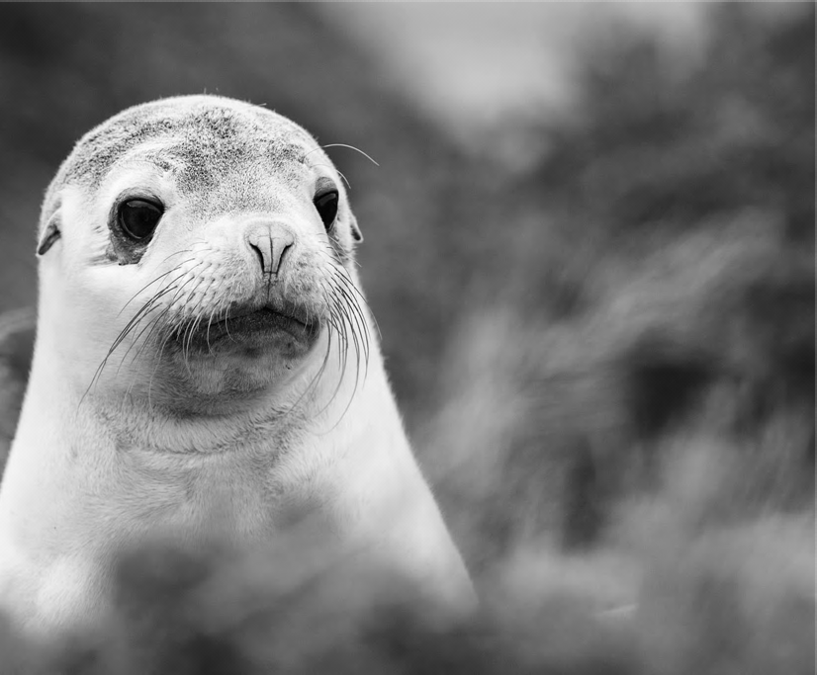
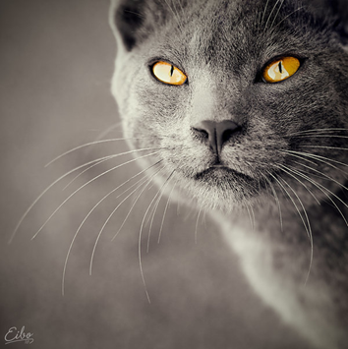
ADD YOUR TITLE
IF YOU LIKE THIS POWERPOINT TEMPLATE,PLEASE FOCUS ON ME,YOU WILL GET BETTER.
CONTRAST
TRIANGLE
ADD YOUR TITLE
IF YOU LIKE THIS POWERPOINT TEMPLATE,PLEASE FOCUS ON ME,YOU WILL GET BETTER.

Slide 27
2
0
CHENYING
0907
1
7
THANKS
Beautiful of Design

Slide 28



可以在下列情况使用
不限次数的用于您个人/公司、企业的商业演示。
拷贝模板中的内容用于其它幻灯片母版中使用。
不可以在以下情况使用
用于任何形式的在线付费下载。
收集整理我们发布的免费资源后，刻录光碟销售。
PPT模板下载：www.1ppt.com/moban/ 行业PPT模板：www.1ppt.com/hangye/
节日PPT模板：www.1ppt.com/jieri/ PPT素材下载：www.1ppt.com/sucai/
PPT背景图片：www.1ppt.com/beijing/ PPT图表下载：www.1ppt.com/tubiao/
优秀PPT下载：www.1ppt.com/xiazai/ PPT教程： www.1ppt.com/powerpoint/
Word教程： www.1ppt.com/word/ Excel教程： www.1ppt.com/excel/
资料下载： www.1ppt.com/ziliao/ PPT课件下载：www.1ppt.com/kejian/
范文下载： www.1ppt.com/fanwen/ 试卷下载： www.1ppt.com/shiti/
教案下载： www.1ppt.com/jiaoan/ 字体下载： www.1ppt.com/ziti/

